Slide 1
EPD Panel and Lattice FPGA Based Business Card

Slide 2
PervasiveDisplay EPD Panel Operating Sequence
Most of the following material and diagrams originate from the document:
E-paper Display COG Driver Interface Timing for 1.44”,1.9”,2”,2.6” and 2.7” EPD with G2 COG and Aurora Mb Film.
The 1.44” TFT EPD Panel is currently being used with the Lattice FPGA Business Card (BC).

Slide 3
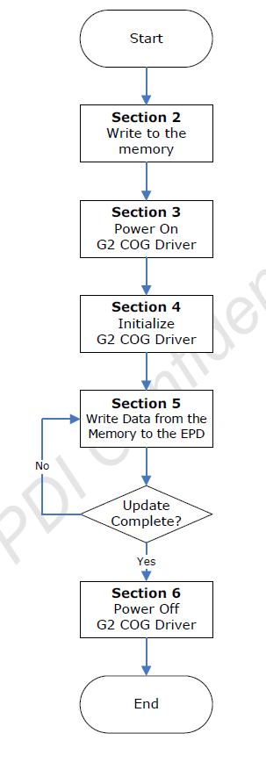
EPD Driving Flow Chart
1
State machine logic for sections 2 , 3, 5, & 6 are implemented in the epaper_cntrl.vhd rtl module.
Each section listed have many steps required to accomplish its specific task.
2
3

Slide 4
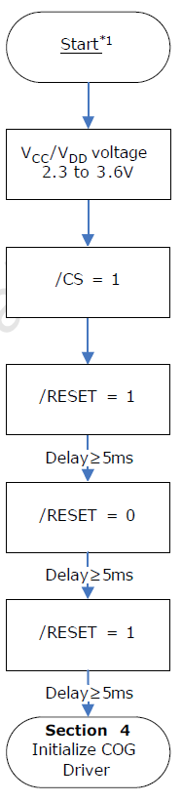
Section 2 : Power On G2 COG Driver
I/O manipulation on startup

Slide 5
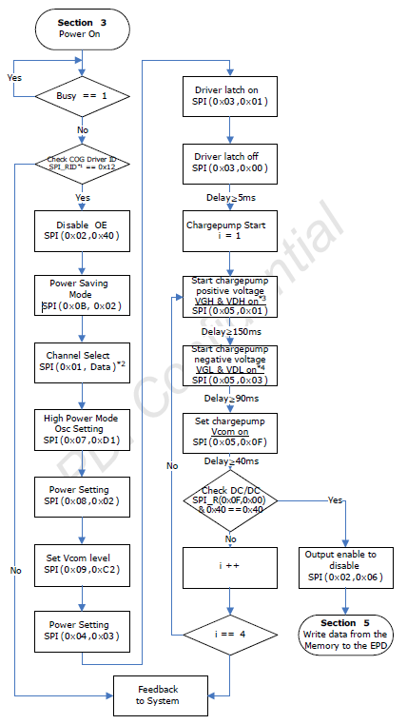
Section 3: Initialize G2 COG Driver
2
Doing Reads on SPI bus but no longer verifying what is received. Always returns x00.
Commands and Data are stored in an array. Delays between commands, if any, are held in another array.
A loop of 3 states perform the applications shown in the rectangular boxes.
4

Slide 6
State Machine for Init G2 COG Driver
Idle
SPI Rd
Check ID
Check DC/DC

Slide 7
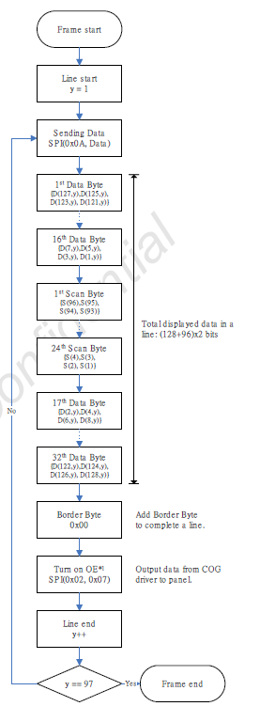
Section 5: Write Data to Display (1.44”)

Slide 8
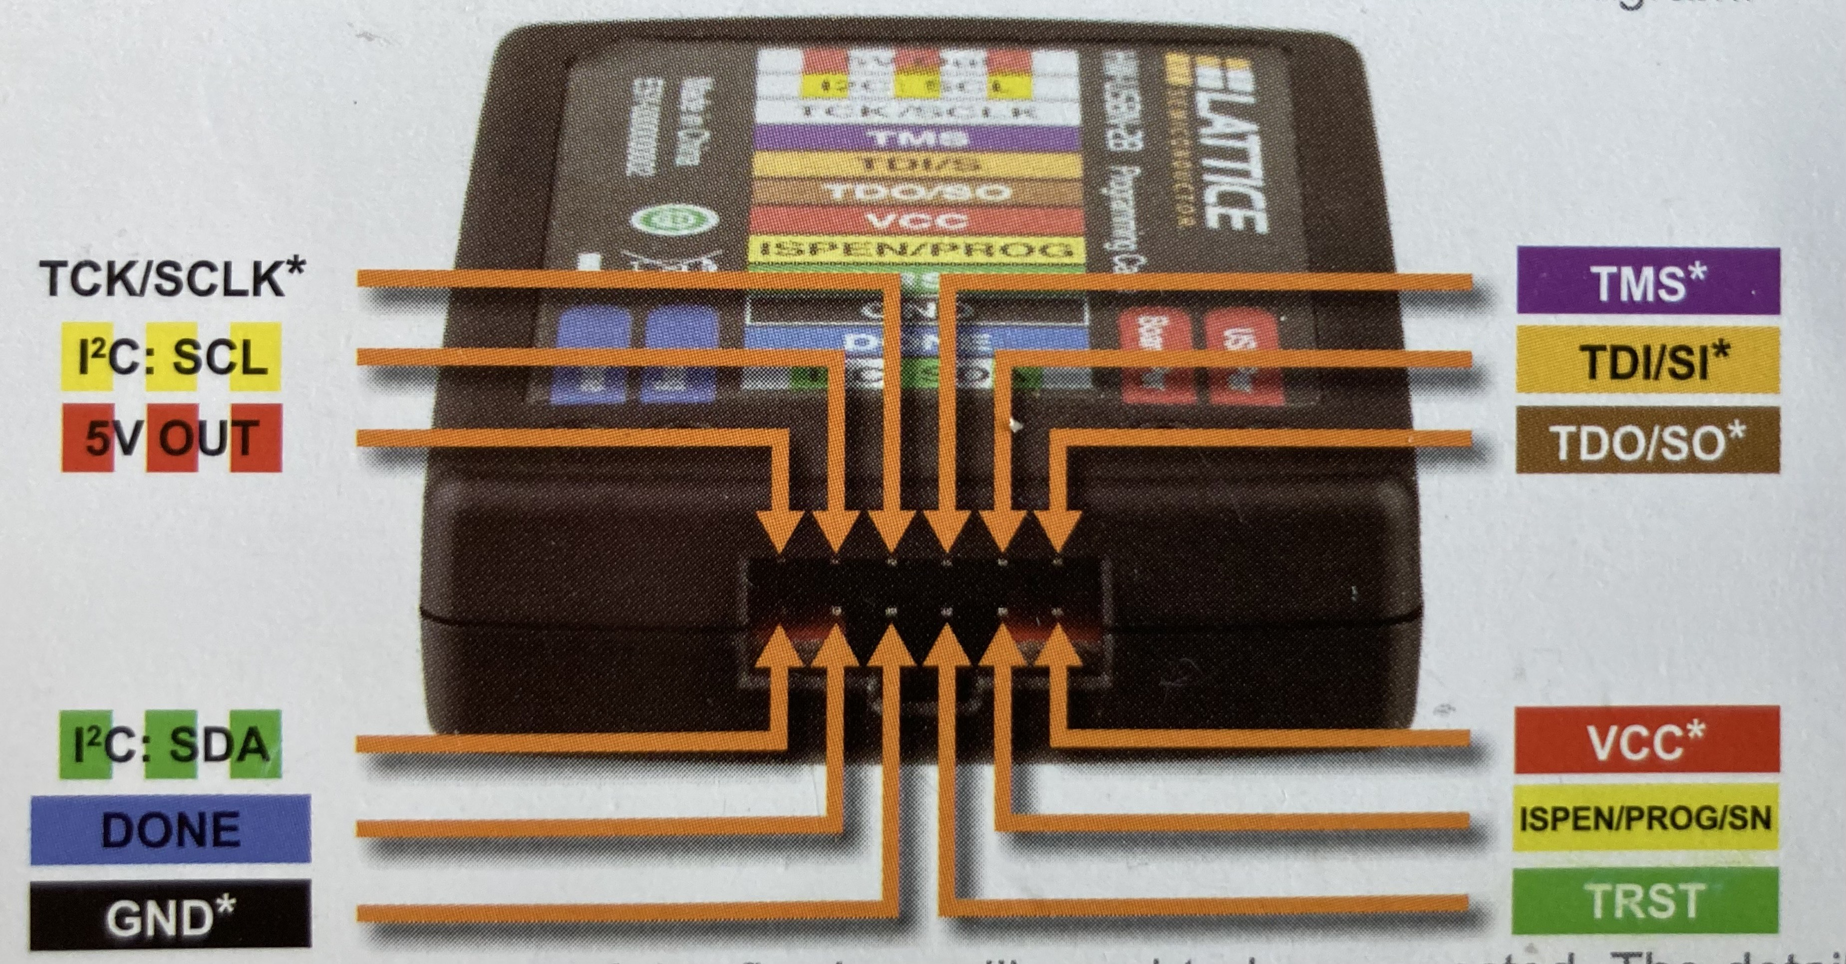
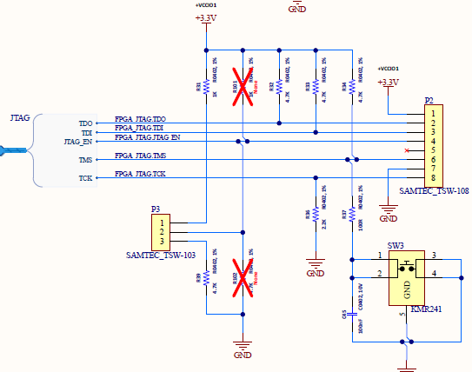
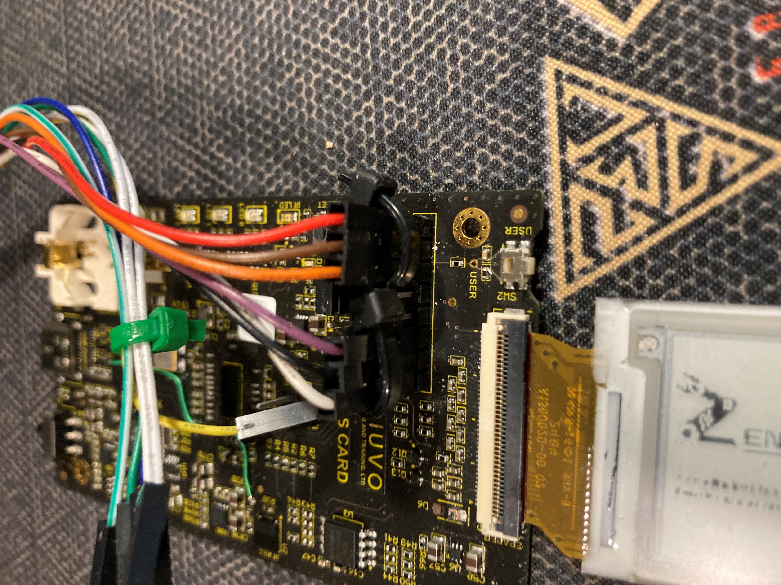
JTAG Connection
HW-USBN-2B JTAG Programmer
Lattice BC board
Signal
Vcc Detect --
TDO ------
TDI ------
TMS ------
GND ------
TCK ------
P2
1
2
3
4
5
6
7
8
Red
Brown
Orange
EN-PU-NC
NC
Purple
Black
White

